Slide 1
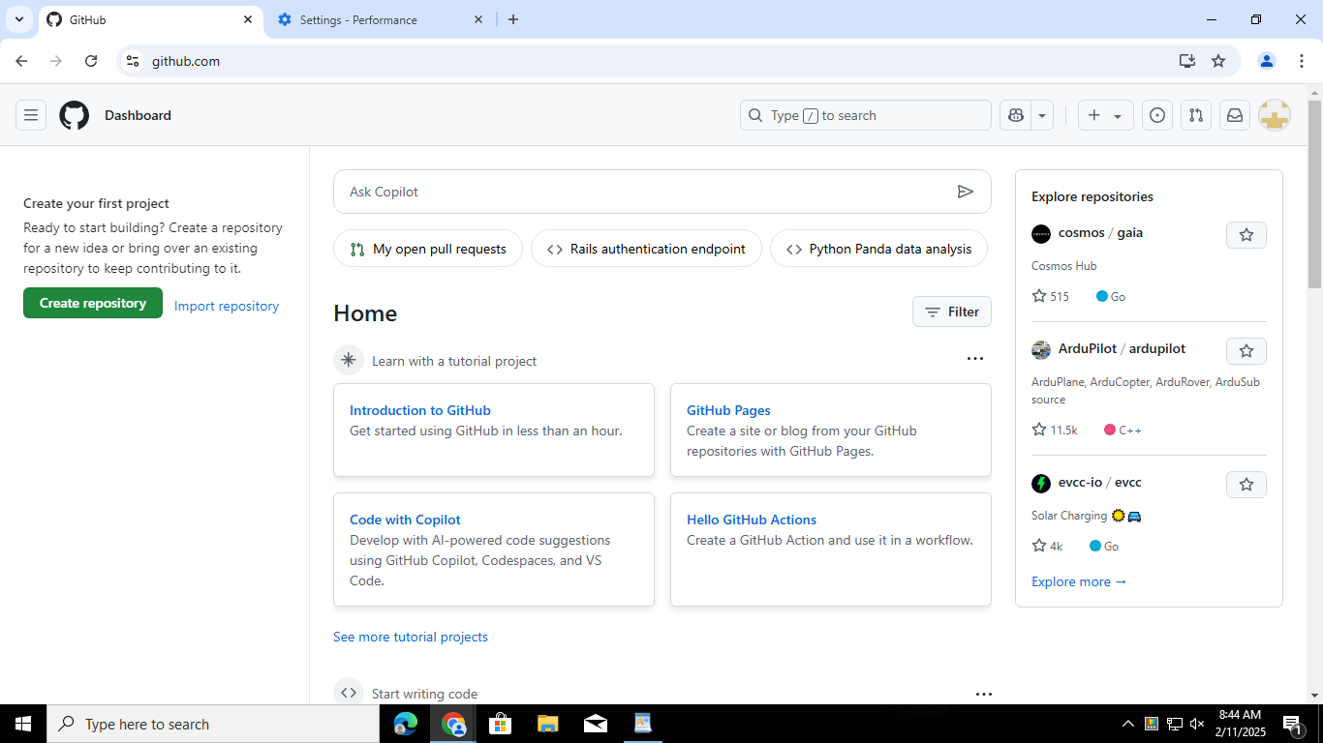
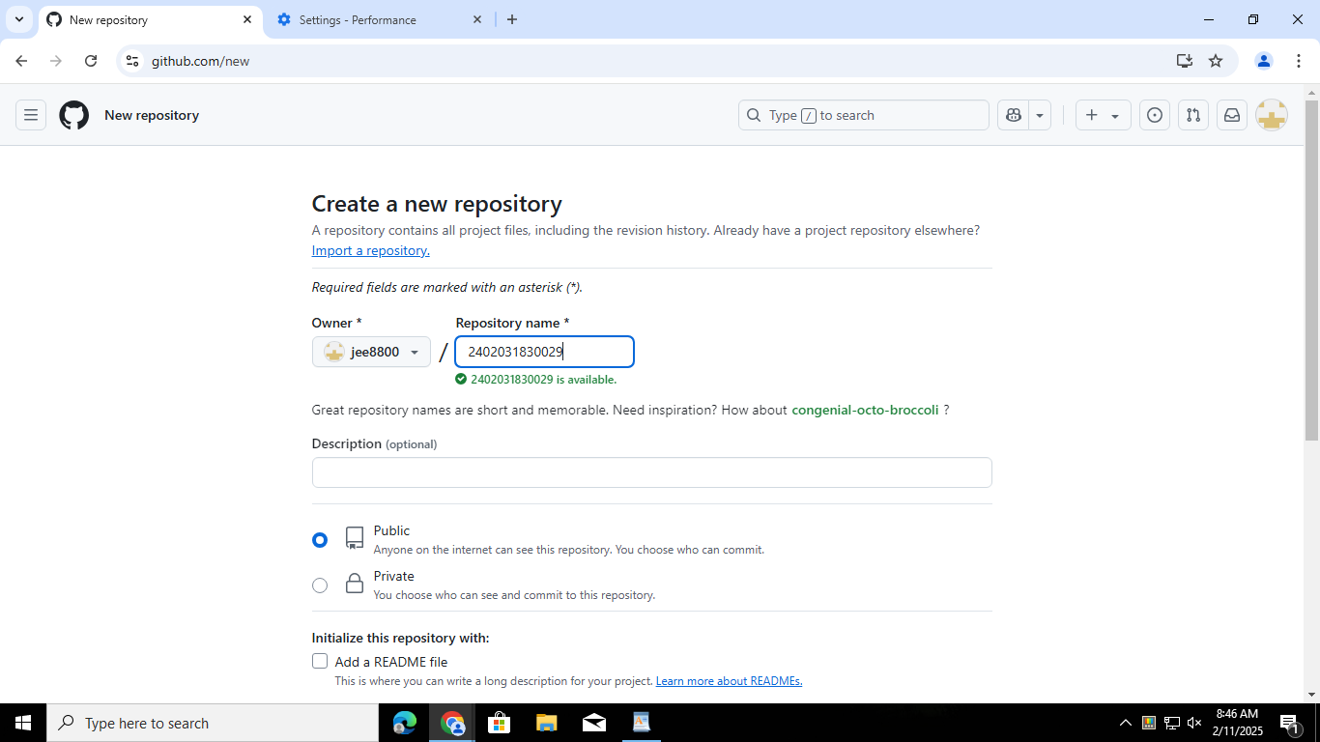
WEB TECHNOLOGY WITH UI UX ASSIGNMENT 1- Task-1 Name - Jenika solanki Roll No:69 Class:4CSE_E BRANCH:CSE step1 step:2

Slide 2
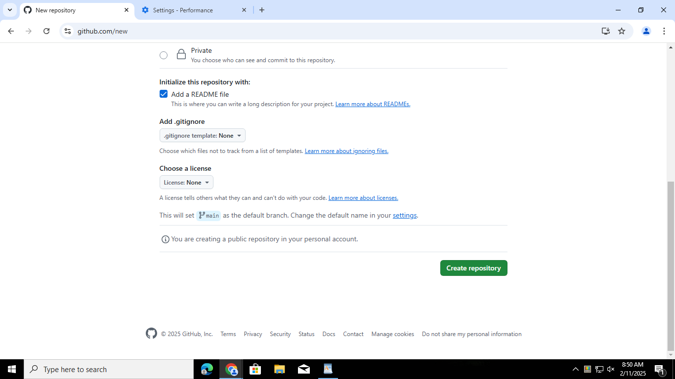
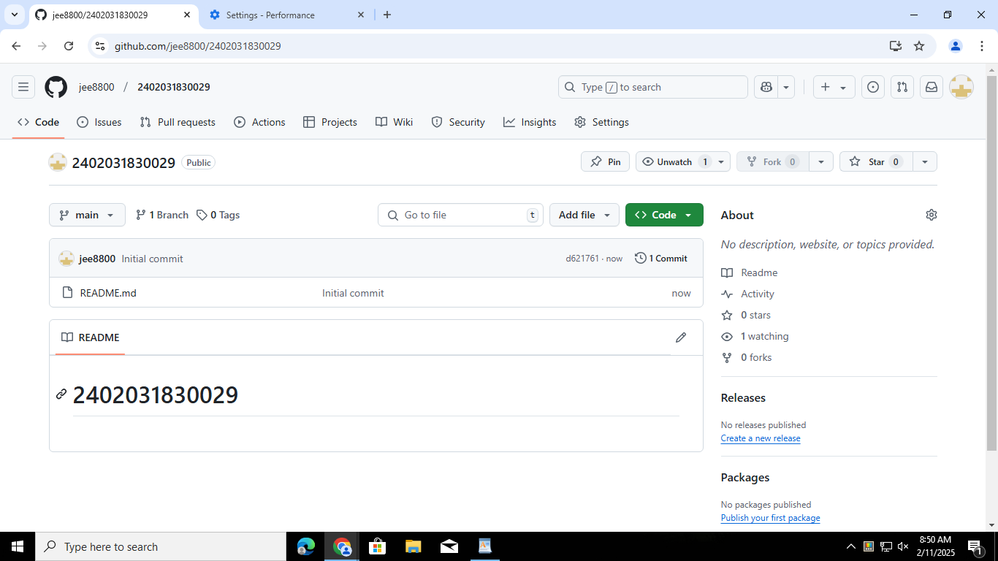
Step:3 Step:4

Slide 3
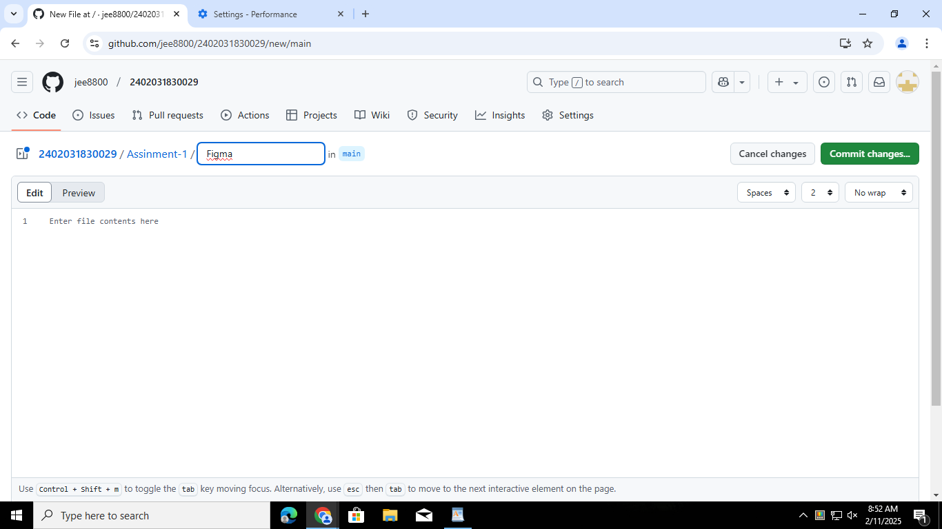
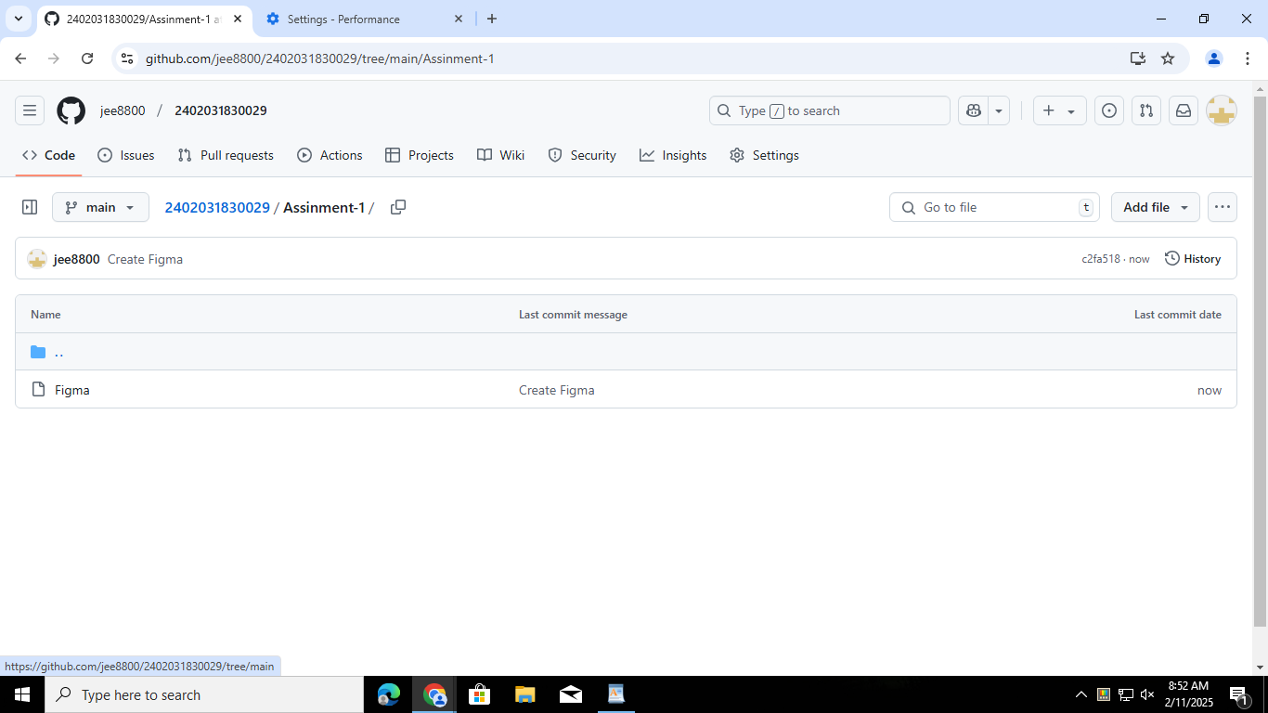
Step:5 Step:6

